Slide 1
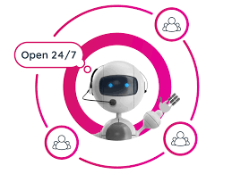
Chat Bot
NLP And Deep Learning

Slide 2
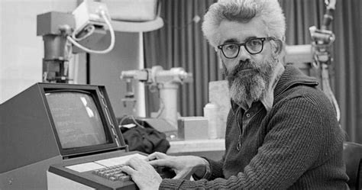
History of chatbots
In the 1960s,The first AI systems ,that were developed,
Could understand and respond to natural language . The ELIZA program ,
Developed by Joseph Weizenbaum ,is one of the first chatbots that can
Simulate a conversation with a human user.

Slide 3
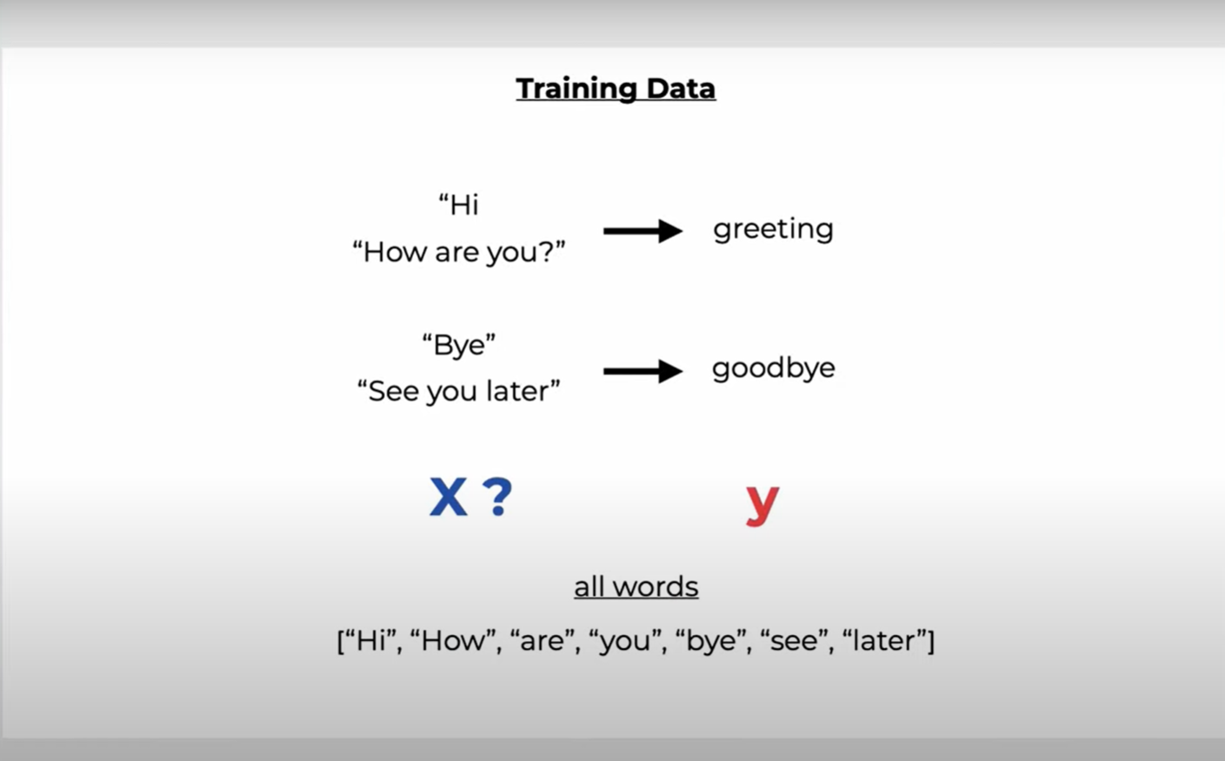
How to set up our training data

Slide 4
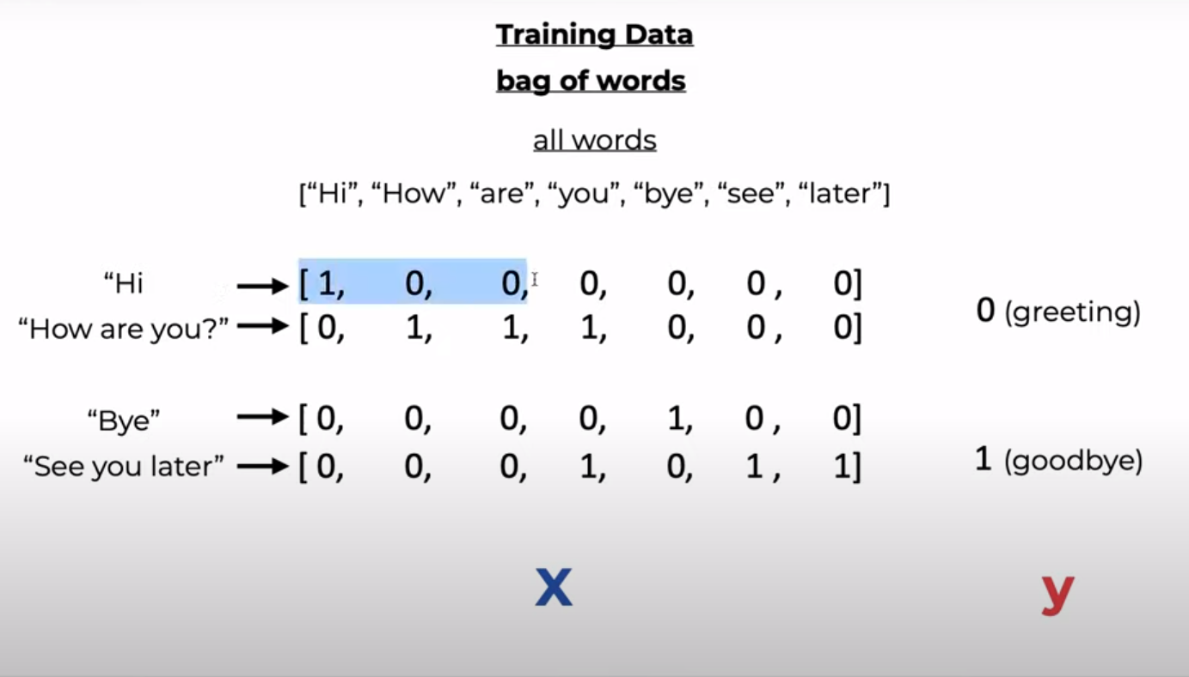
Bag of word array

Slide 5
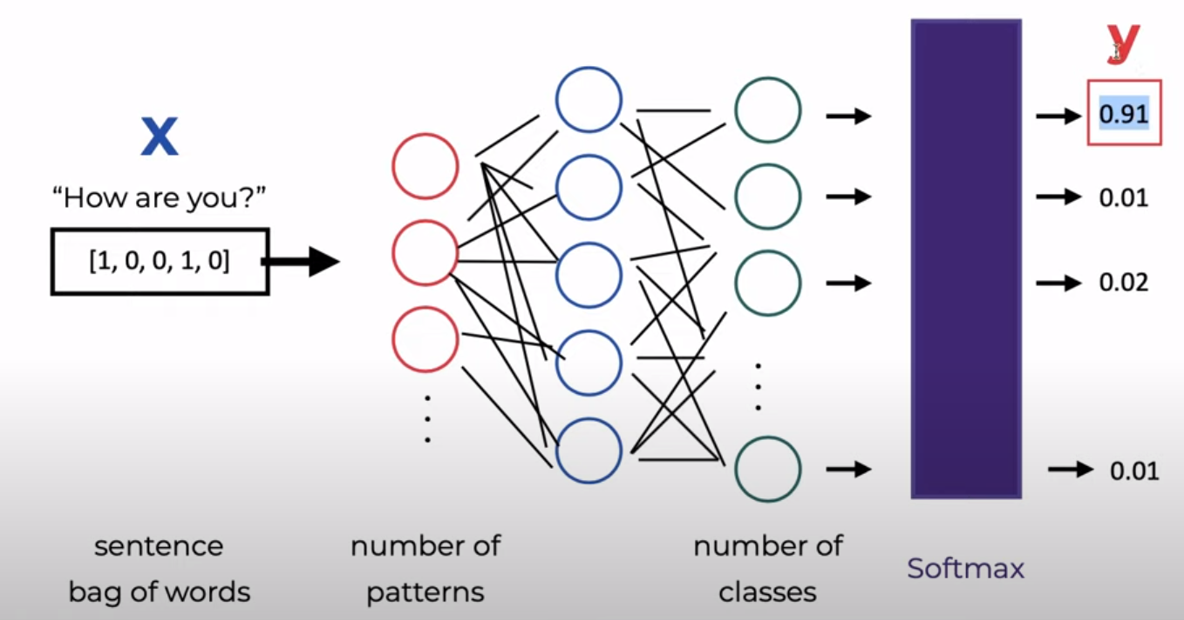
Feed forward neural network

Slide 6
We need to apply two NLP Techniques

Slide 7
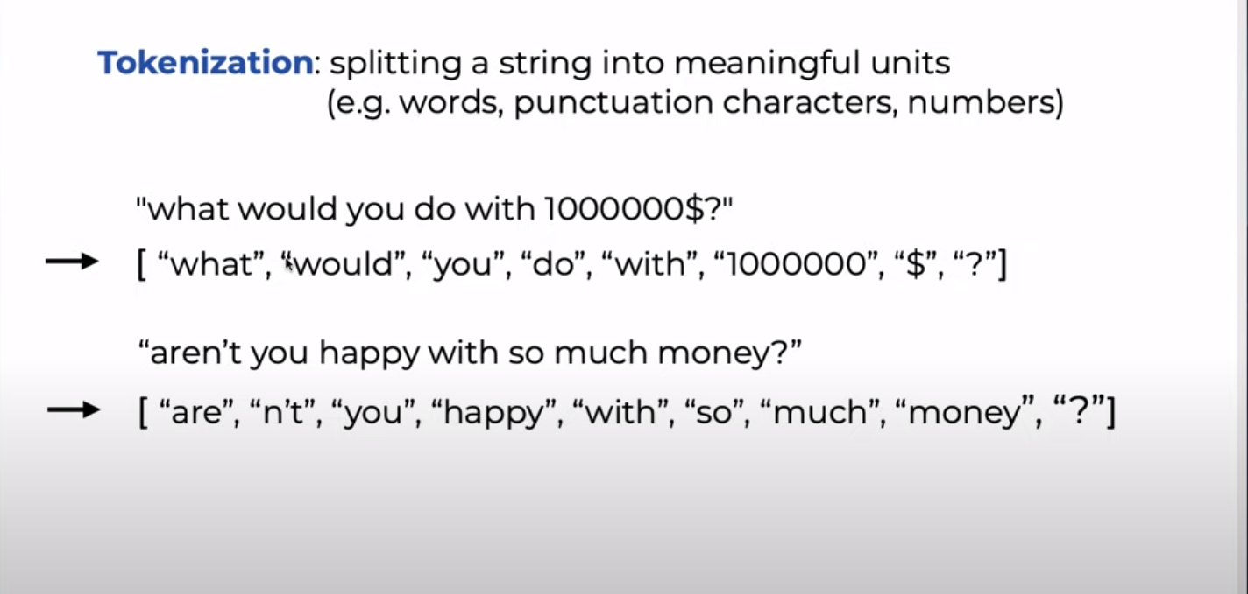
Tokenization

Slide 8
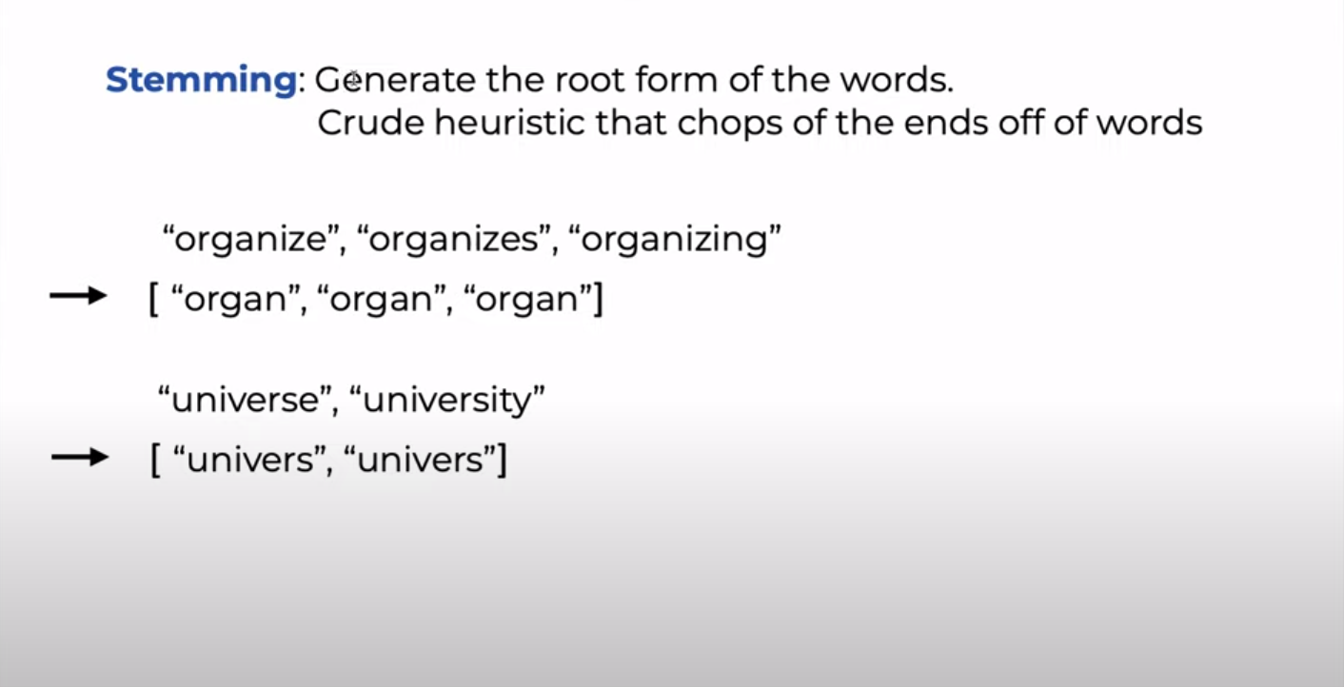
Stemming

Slide 9
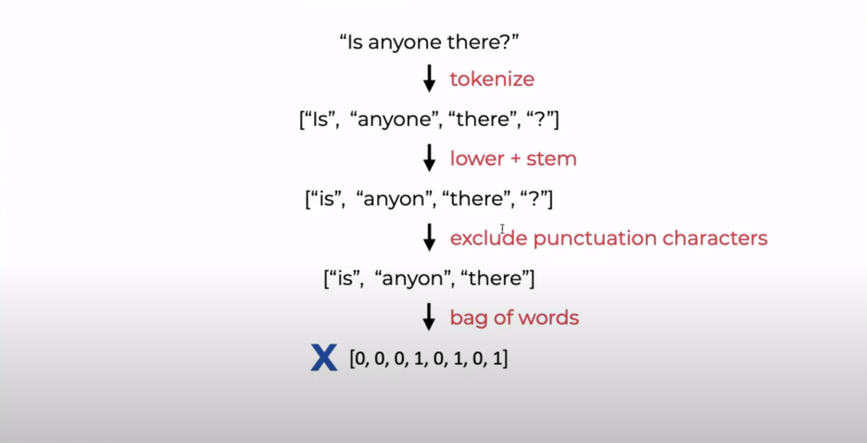
NLP Preprossing Pipeline

Slide 10
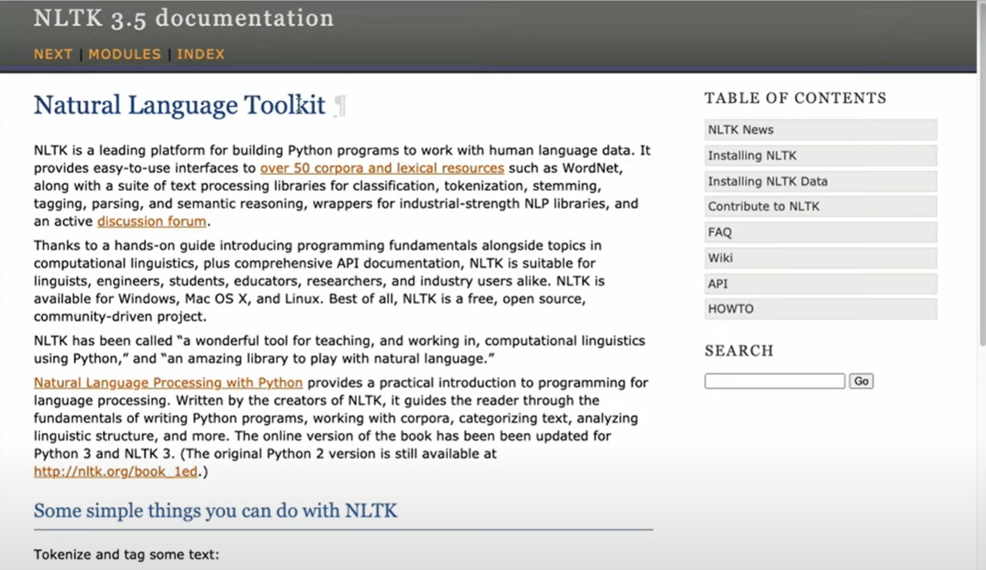
What we gone use
nltk Frame work
To deal with
1-tokenization
2-stemming

Slide 11
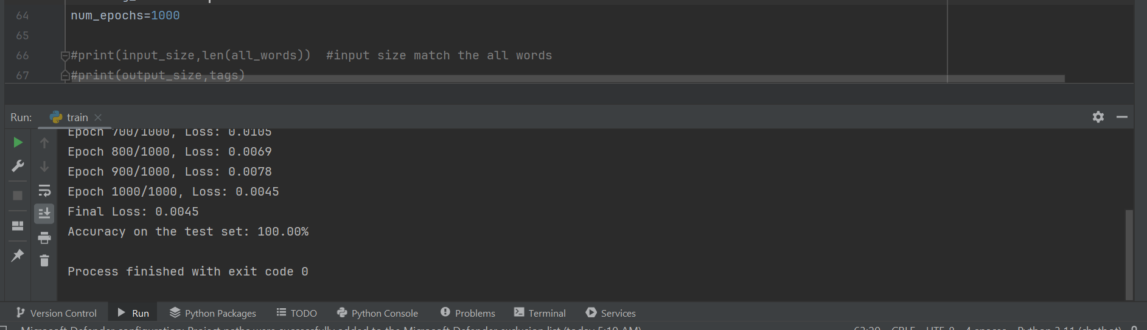
Total accuracy of the model

Slide 12
Thank You

